Slide 1
Advanced Systems
Tutorial Solutions: Midland Hotel, QuickMed, & CampusRide Cases

Slide 2

Introduction
Software engineering design principles applied to domain modeling and system architecture across three case studies.
Focus on clear separation of domain concepts and product responsibilities, validation techniques for tacit requirements, and modular workflow design for front-desk operations.

Slide 3
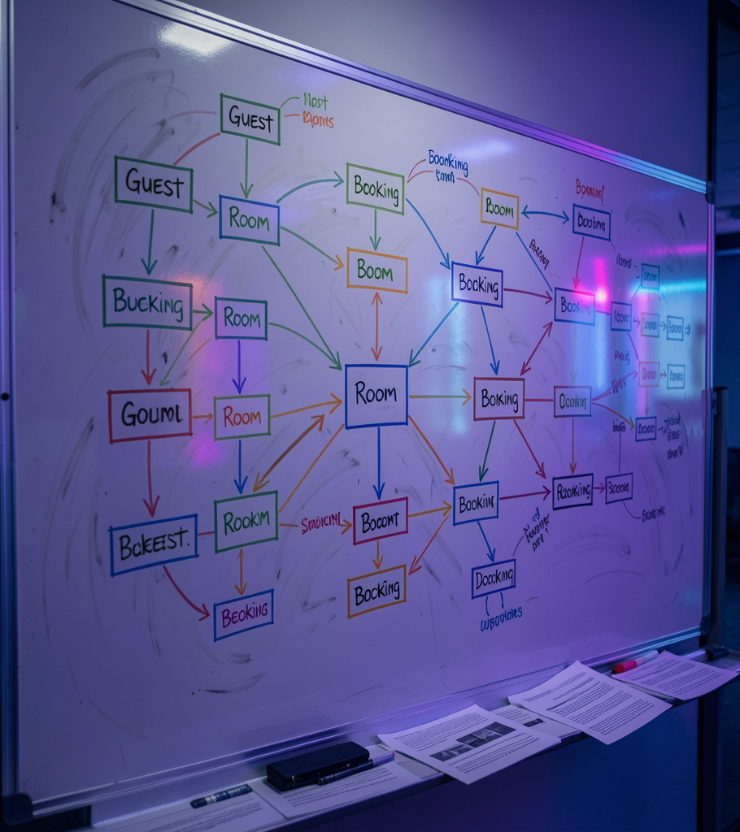
01
Domain Modeling

Slide 4
Receptionist Role
The receptionist is a core domain actor performing real-world tasks independent of any product.
Model as a Domain Entity with behaviors (greet, manage keys, verify identity). Keep UI/services as Product-layer adapters to avoid leaking business rules.

Slide 5
Room Type Entity
Introduce RoomType as a lookup/meta-data class (Single, Double, Suite) referenced by Room via a foreign key.
This enables dynamic property checks and avoids hardcoding. Use explicit relationships and validation rules to maintain integrity and support pricing/availability variance.

Slide 6

Tacit Requirements
The hidden rule: rooms cannot be reassigned until Housekeeping marks them Cleaned and Inspected.
Use activity diagrams to validate lifecycle transitions with stakeholders.
Force articulation with variants & problems tasks (exception scenarios) to reveal unspoken constraints.

Slide 7
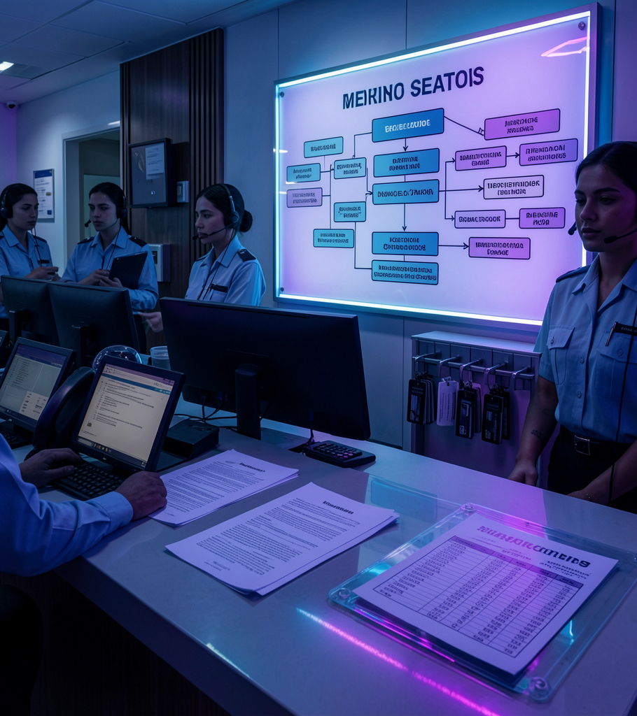
02
Operational Workflows

Slide 8

Front-Desk Tasks
Book Room: query availability and reserve inventory.
Check-in: verify booking, confirm Cleaned state, set to Occupied.
During Stay & Check-out: record incidental charges and finalize billing workflows.

Slide 9
Check-Out Matrix
Consolidate Expenses — Delayed receipts → Real-time POS ledger syncing.
Process Payments — Split billing → Modular transaction architecture.
Trigger Housekeeping — Clerk omission → automated state change to Dirty on invoice settlement.

Slide 10
Check-In Split
Pre-Booked: fast read path—validate Booking ID and room state.
Walk-In: write-heavy path—create booking, calculate dynamic pricing, assign room.
Separate modules preserve clean code and align with CQRS for optimized read/write flows.

Slide 11
Conclusions
Domain-first modeling isolates real-world actors (e.g., Receptionist) from product concerns.
Explicit lookup entities (e.g., RoomType) and validated workflows uncover tacit rules and reduce runtime errors.
Modular task separation (pre-booked vs walk-in) supports maintainability and scalable architecture.

Slide 12
Thanks!

